Slide 1
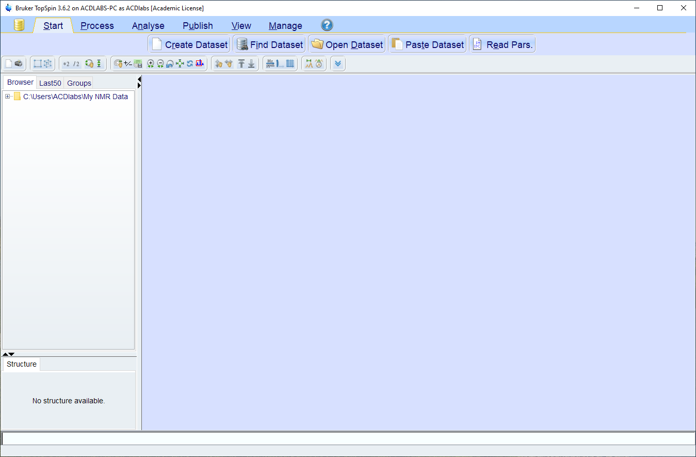
When you open TopSpin it usually looks something like this… there
is no dataset open yet.

Slide 2
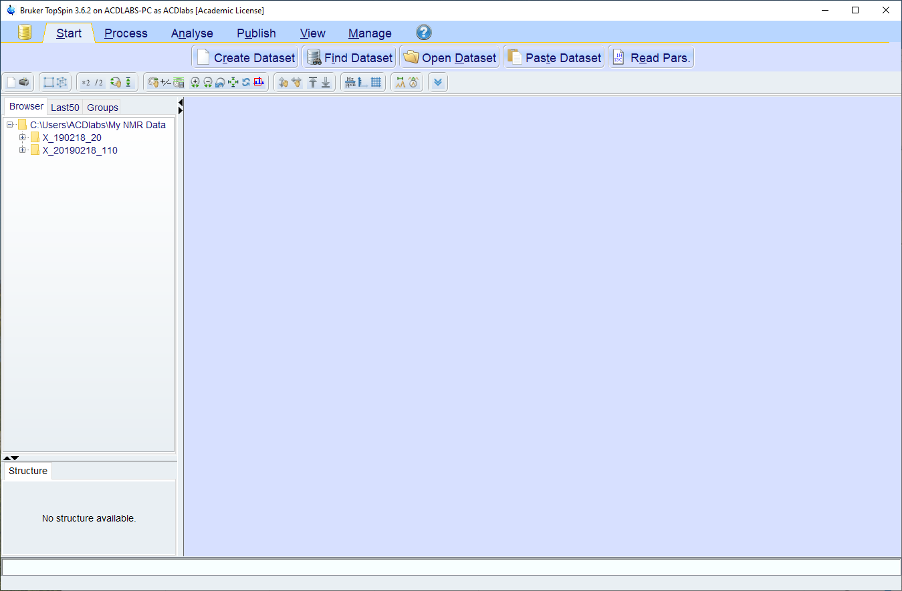
When you click on the “+” next to the folders in the browser pane
it will expand to the next level.

Slide 3
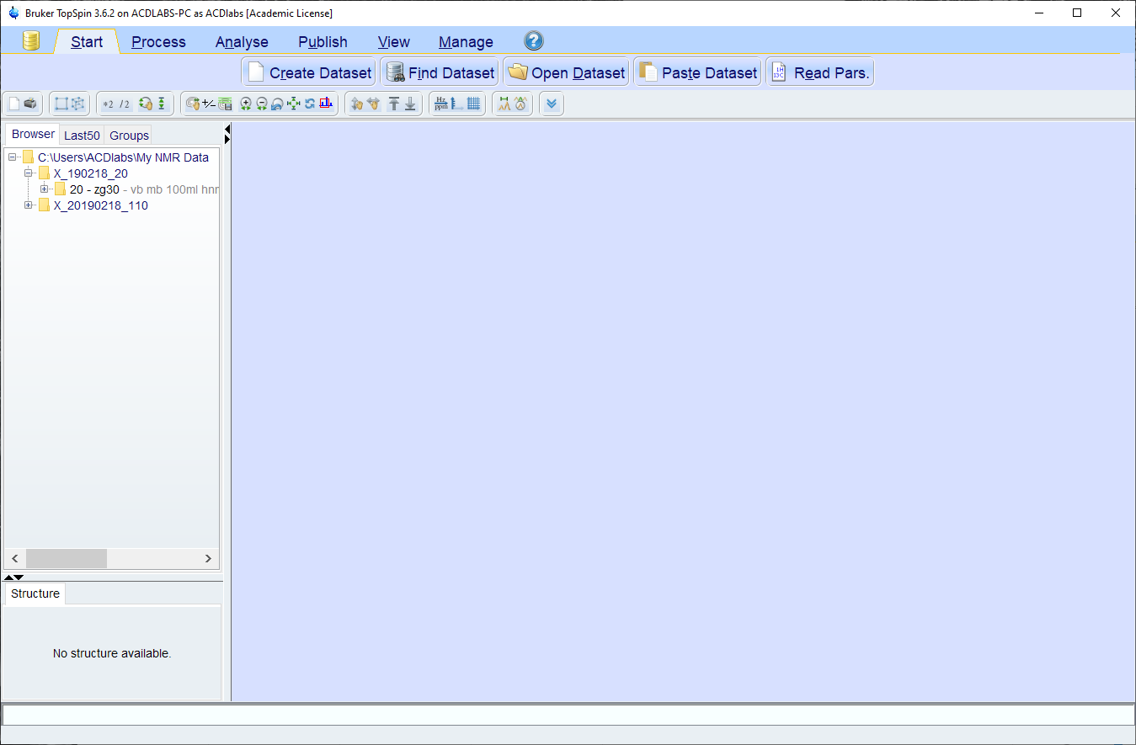
The first level is the experiment name, the next level is the experiment
number (here, 20).

Slide 4
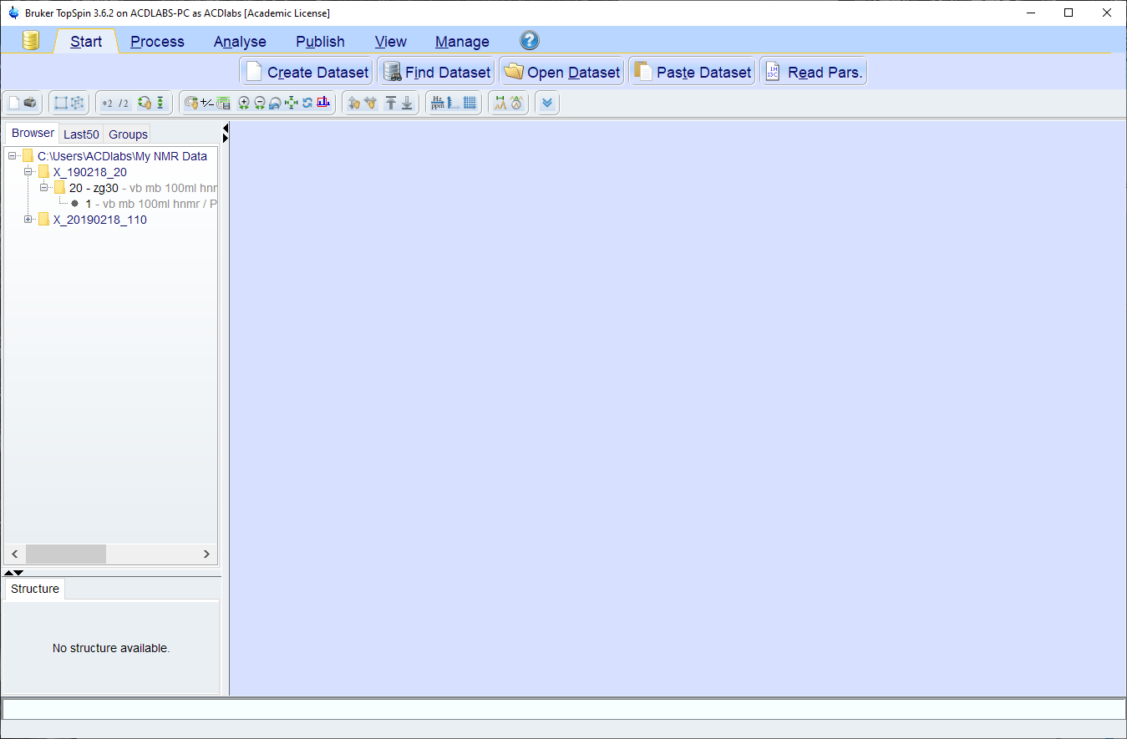
The bottom level (usually a “1”) is the processed data for the
experiment – double-click on it and the spectrum will be displayed.

Slide 5
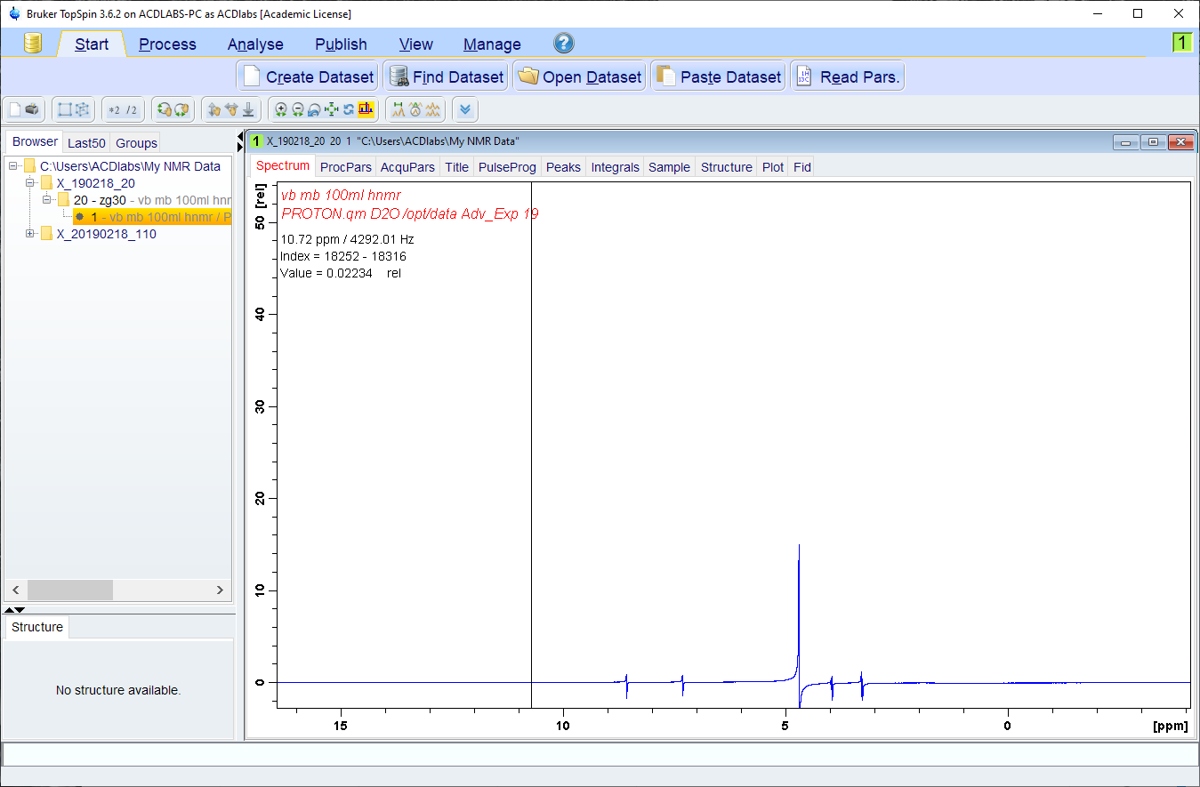
Often, when you open it the data will look like this… the lines are
out of phase. They should be absorptive, these are dispersive.

Slide 6
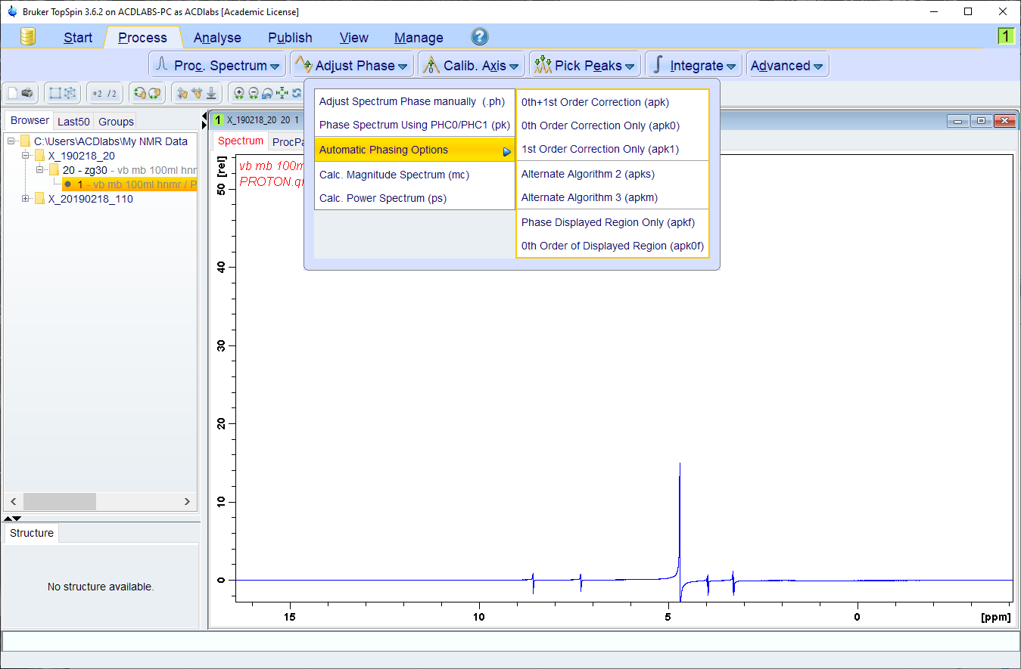
If you choose the Process tab, then the “Adjust Phase” menu, you
will get a number of options for correcting the phase.

Slide 7
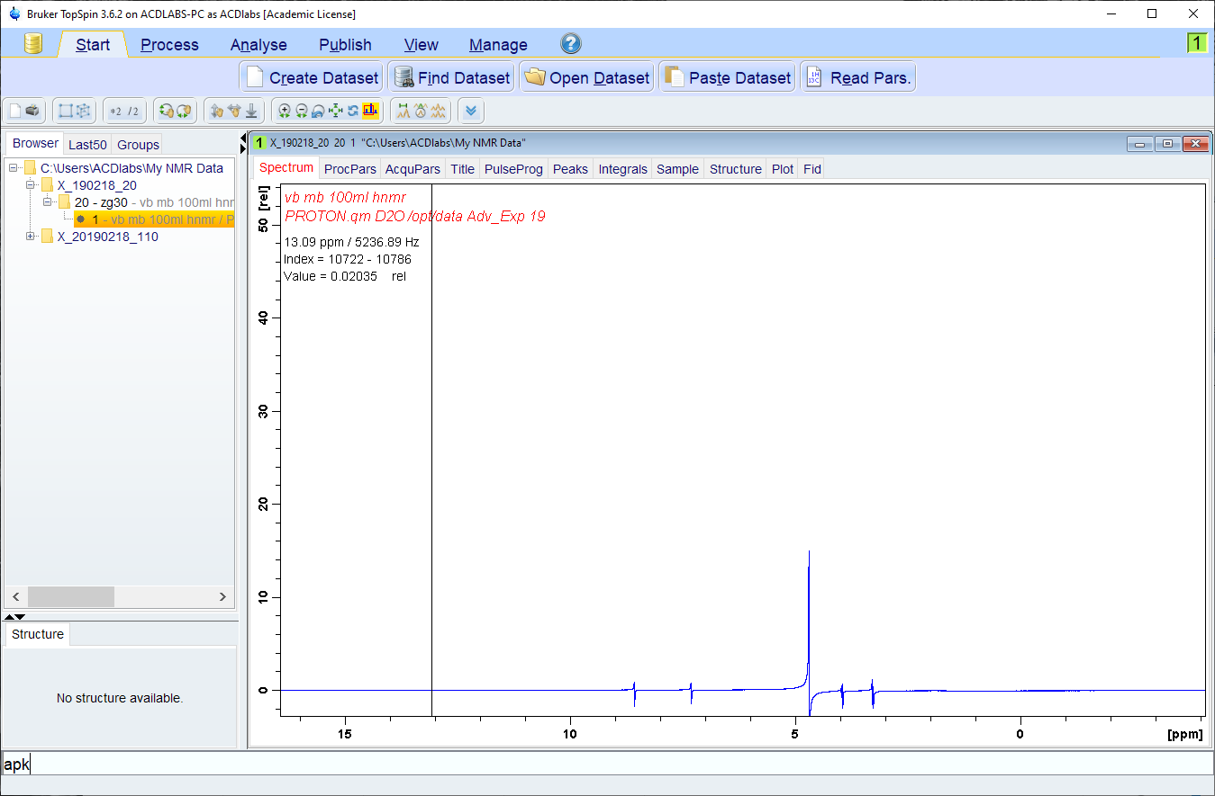
All of the commands can also be typed in to the box at the bottom
of the TopSpin window.

Slide 8
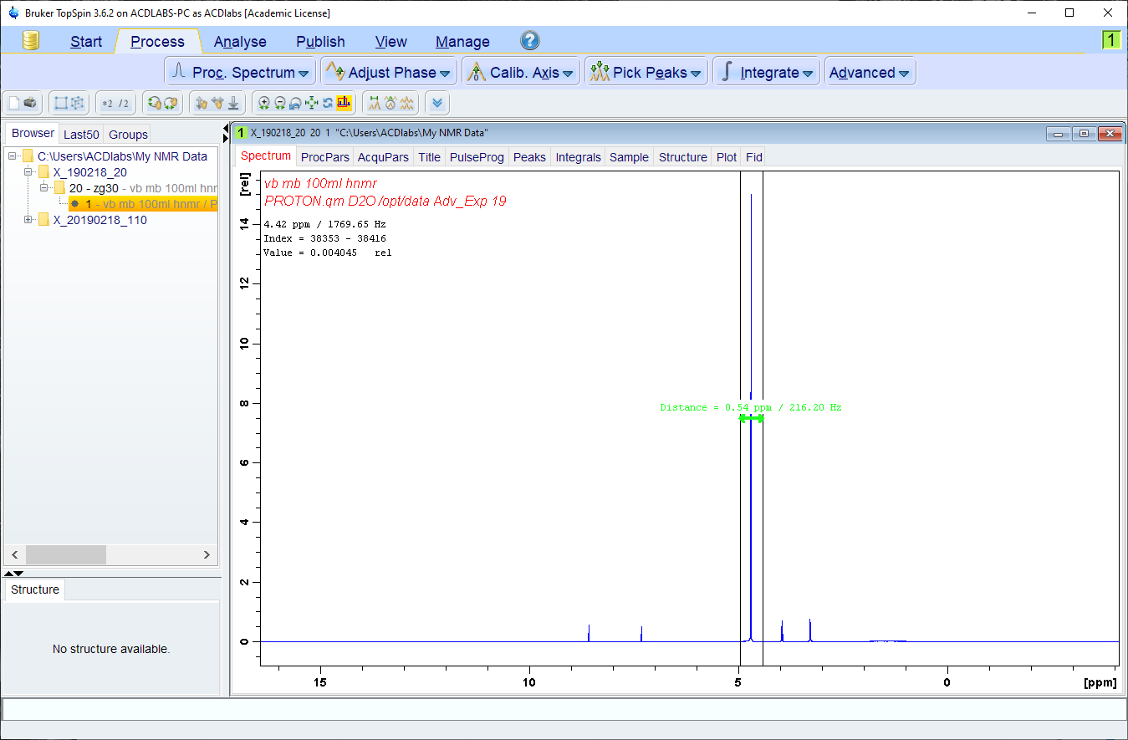
To expand a region of the spectrum click (and hold) the cursor on
One side then drag the cursor over the region you want expanded.

Slide 9
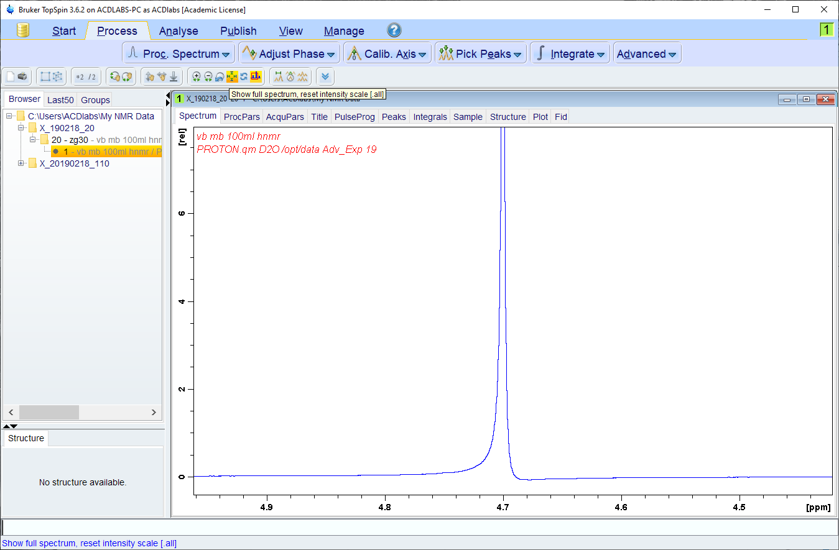
You can adjust the vertical scale with the mouse wheel (or scroll-pad)
When you do, you may find that the phase still isn’t quite right.

Slide 10
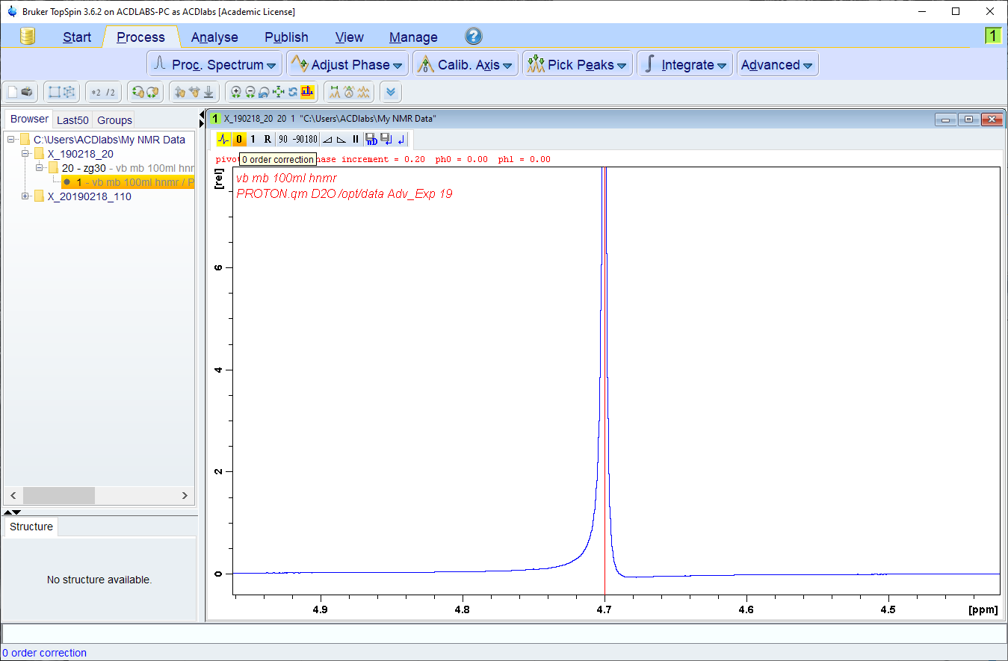
Click on the “Adjust Phase” button to enter manual phasing, then click
And hold on the “0” button. Sliding the mouse will adjust the phase.

Slide 11
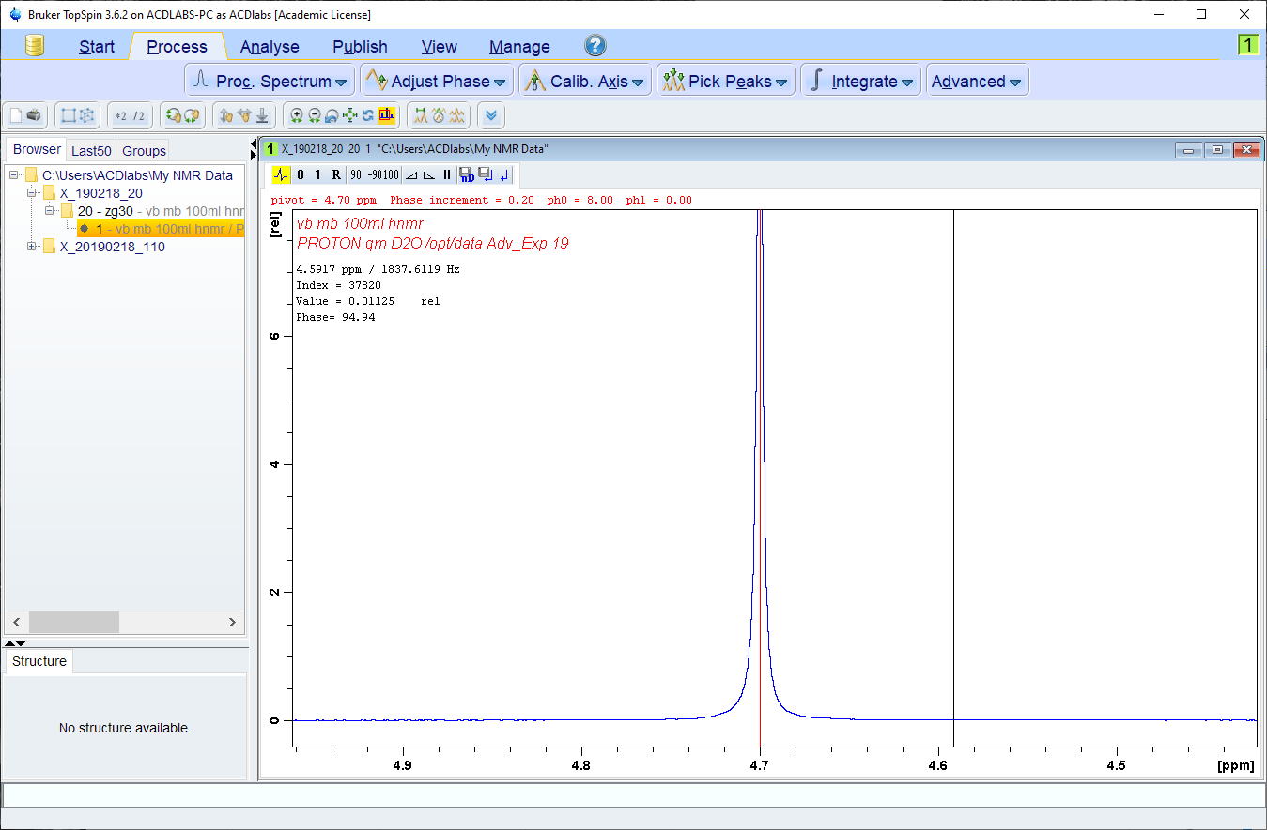
The phase is correct when the baseline is flat on either side of the peak
that has a red line on it (referred to as the “pivot point”).

Slide 12
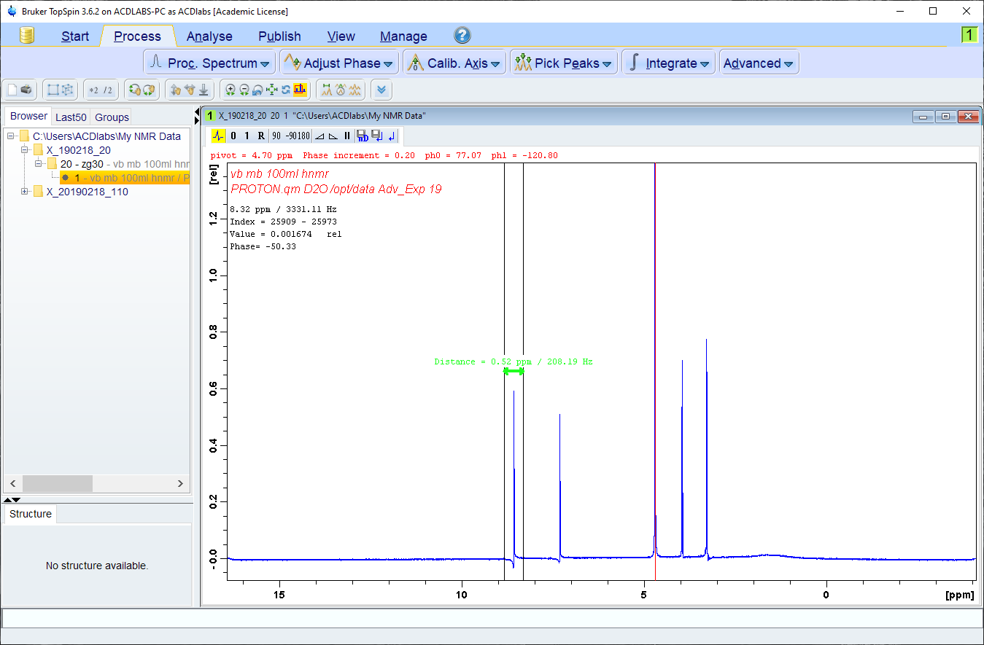
But you may find that lines away from the pivot point are now out of
phase. Expand the line furthest from the pivot point.

Slide 13
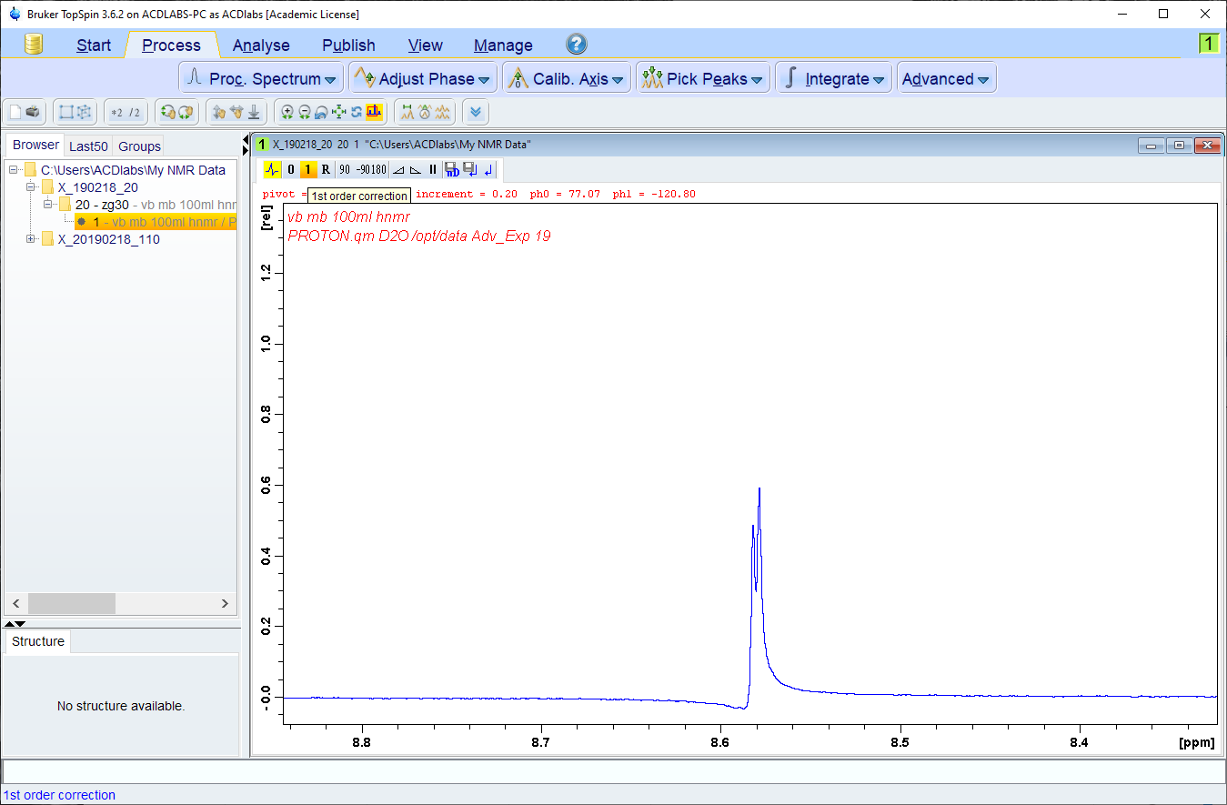
The rest of the spectrum needs a frequency dependent phase
correction which is done by clicking/holding/dragging the “1”.

Slide 14
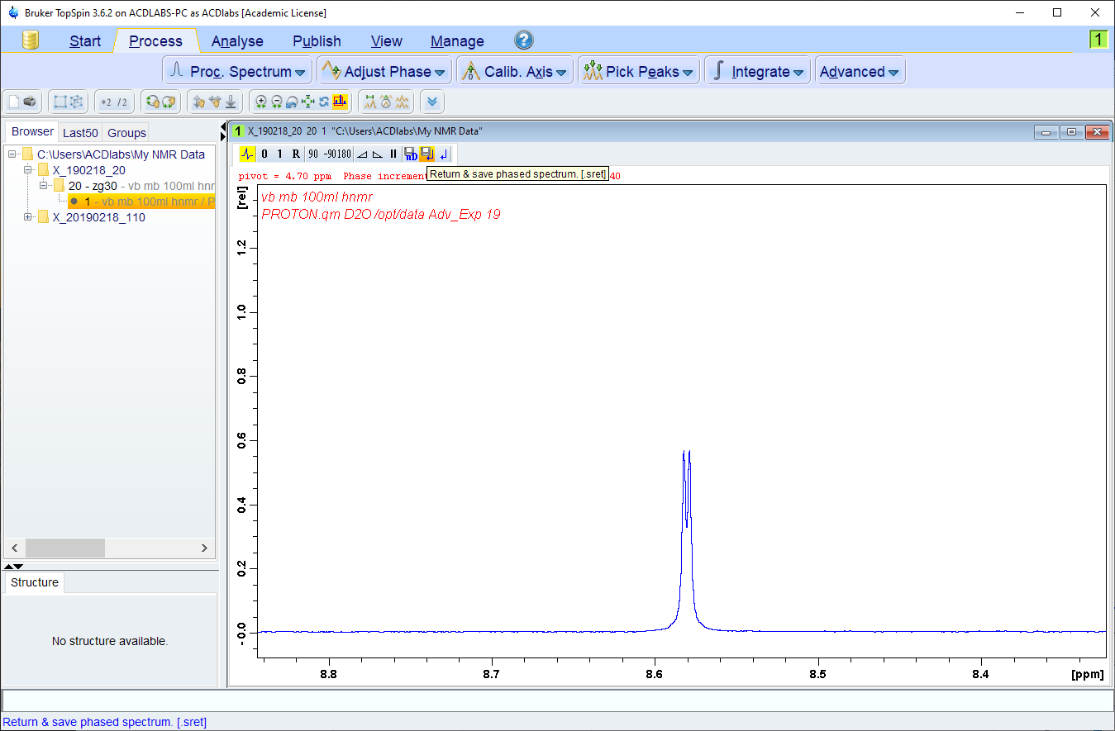
When you are happy with the phasing you need to save the result
by clicking on the save icon (looks like a floppy disk).

Slide 15
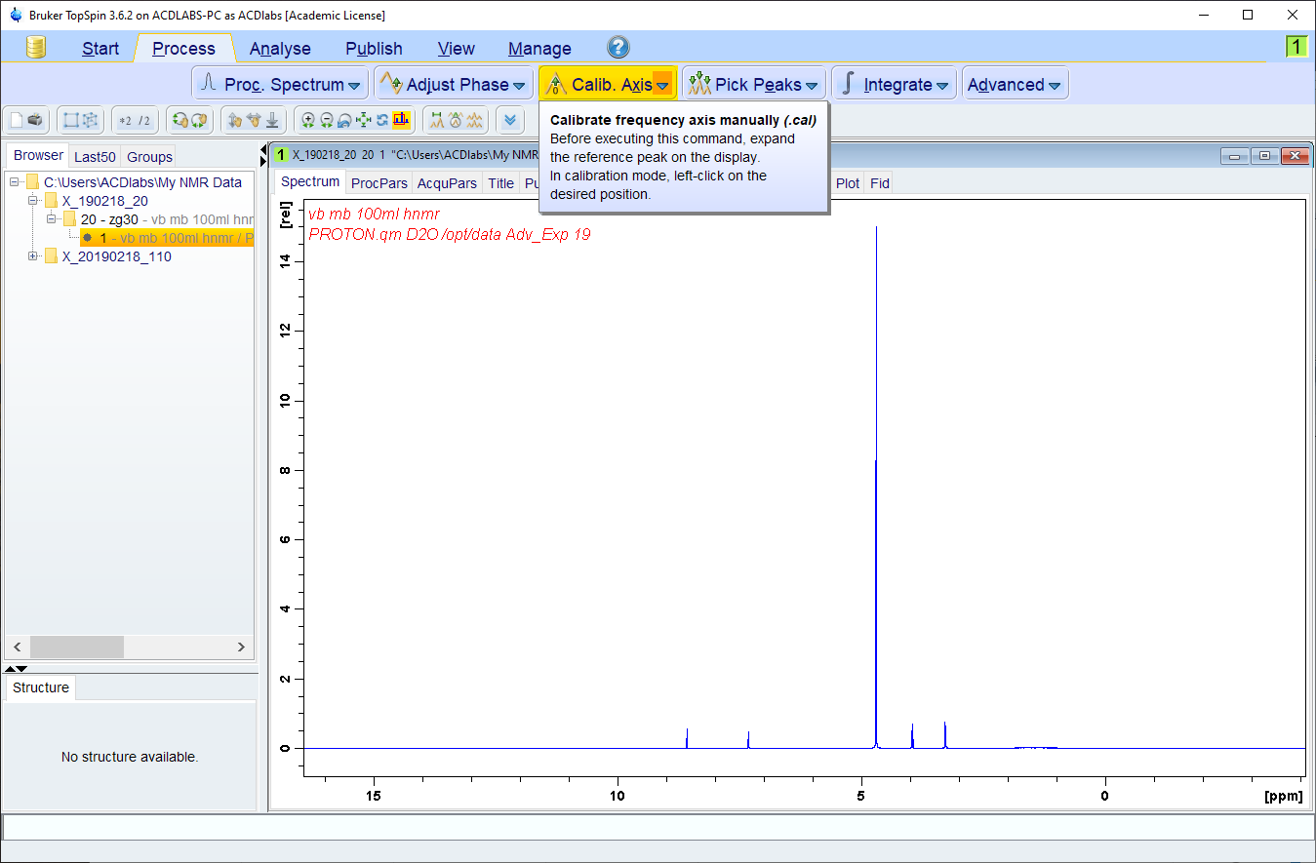
If there is a reference compound (such as TMS) you should now
set it to 0 ppm. This needs to be done before anything else.

Slide 16
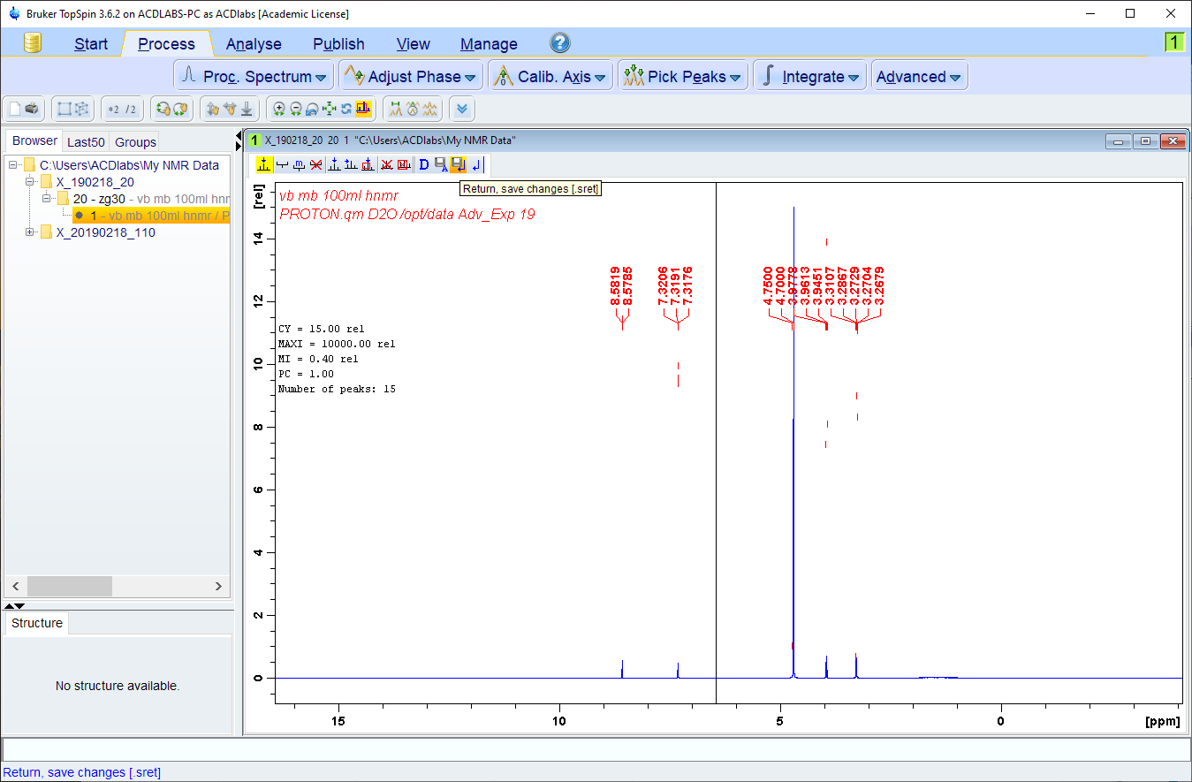
If you select “Pick Peaks” the program will automatically select the
Peaks and enter a mode where you can edit the selection.

Slide 17
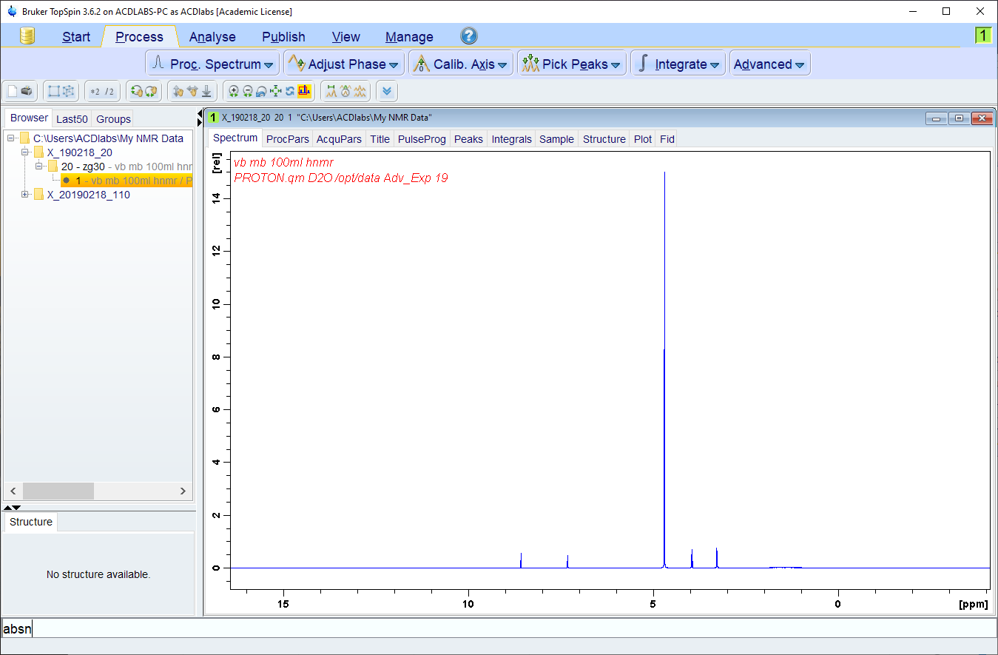
The last piece of processing is baseline adjustment. The automatic
version works quite well using the command abs(n).

Slide 18
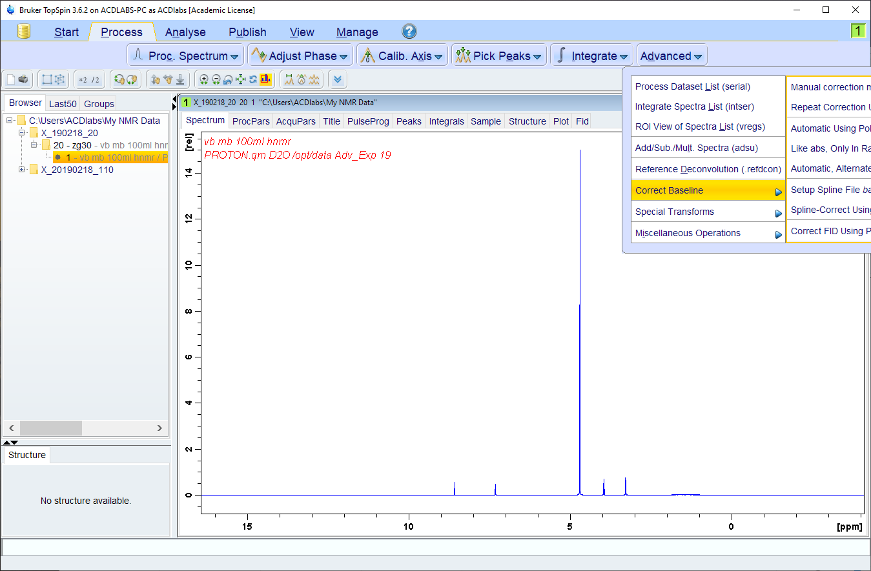
You will find more baseline correction options under the “Advanced”
menu. It’s the one place where the work-flow is out-of-order.

Slide 19
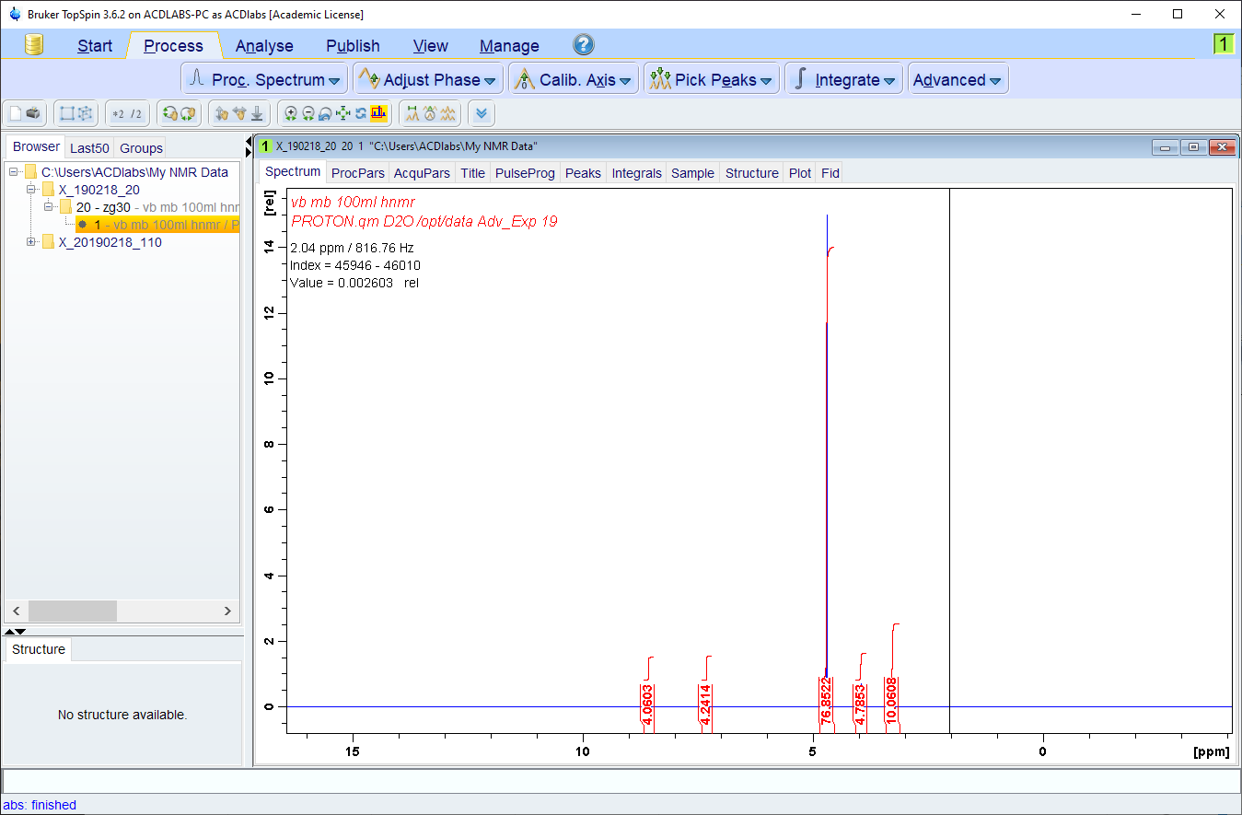
abs will create default integrals, absn performs baseline correction
but does not create integrals… leaving you to do so manually.

Slide 20
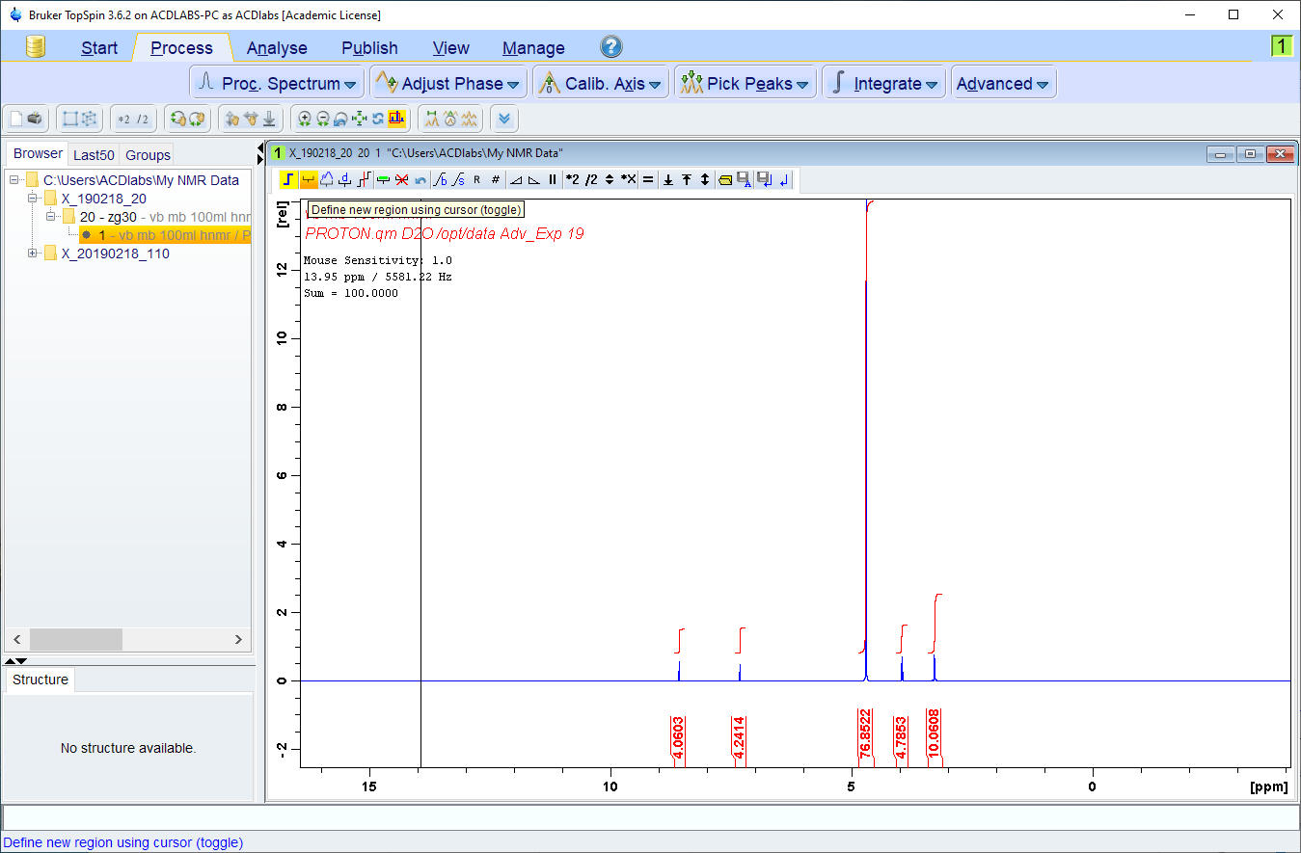
In integration mode. The first icon along enables you to switch
between the cursor’s integration and expansion modes.

Slide 21
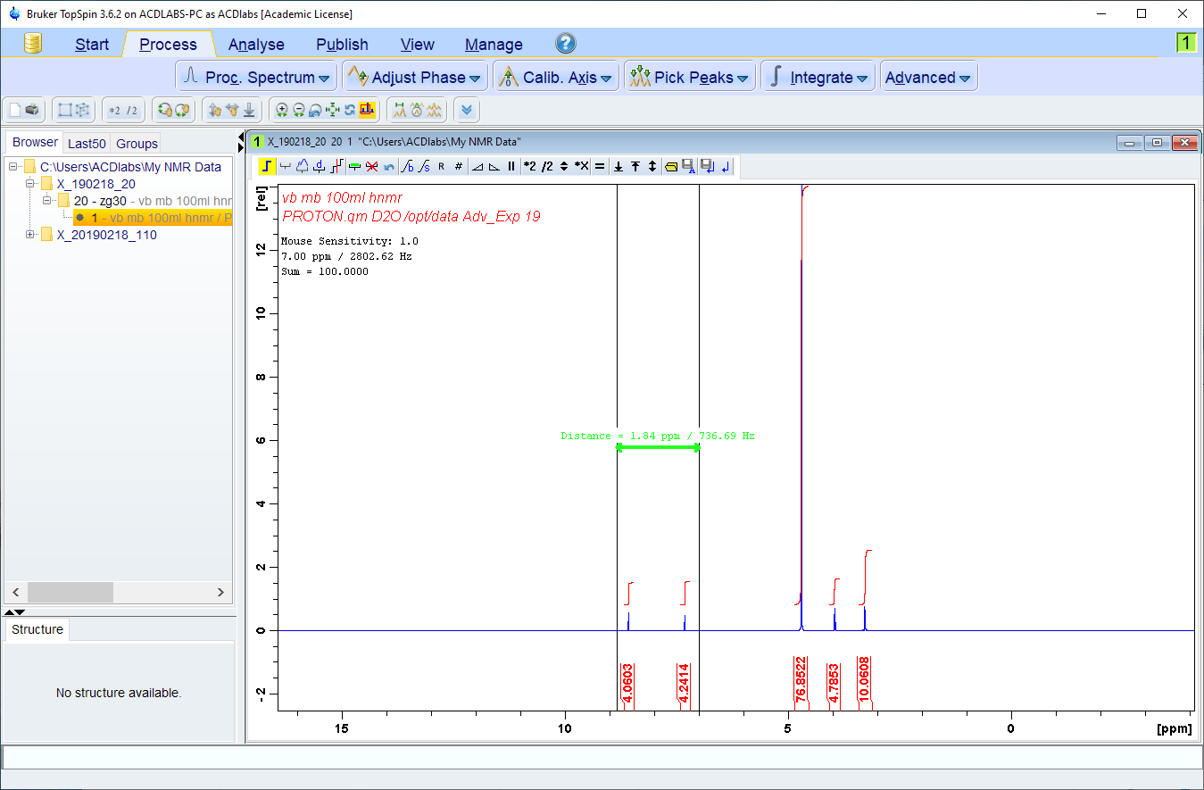
When the icon is not selected you can expand regions of the
spectrum as usual.

Slide 22
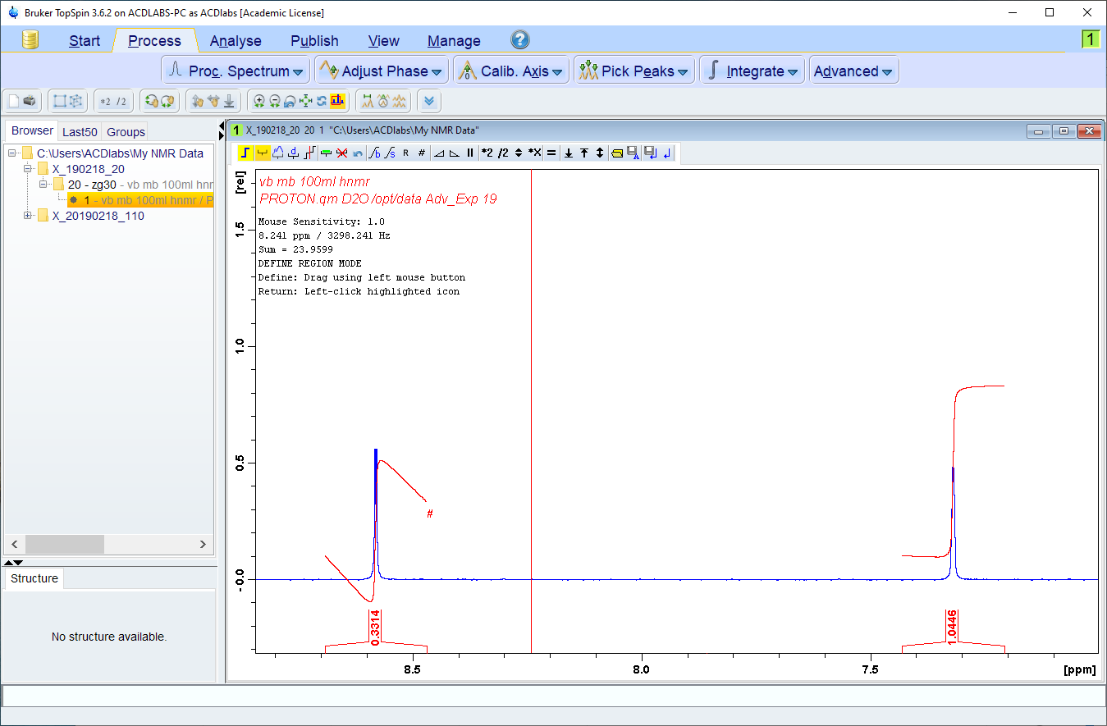
Sometimes a peak (or multiplet) will give a strange looking integral.
The slope and bias of that integral need to be manually adjusted.

Slide 23
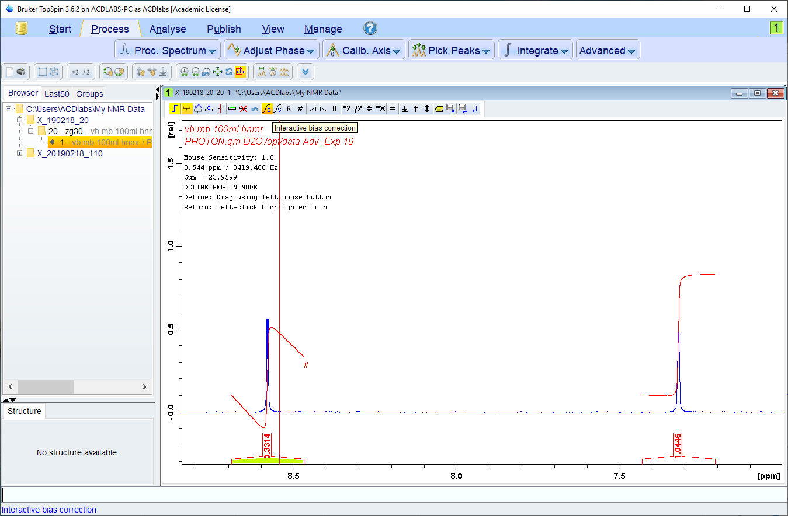
You can select an integral by right-clicking on it (a menu pops up
with “Select” as an option. Bias is adjusted with the “b” icon.

Slide 24
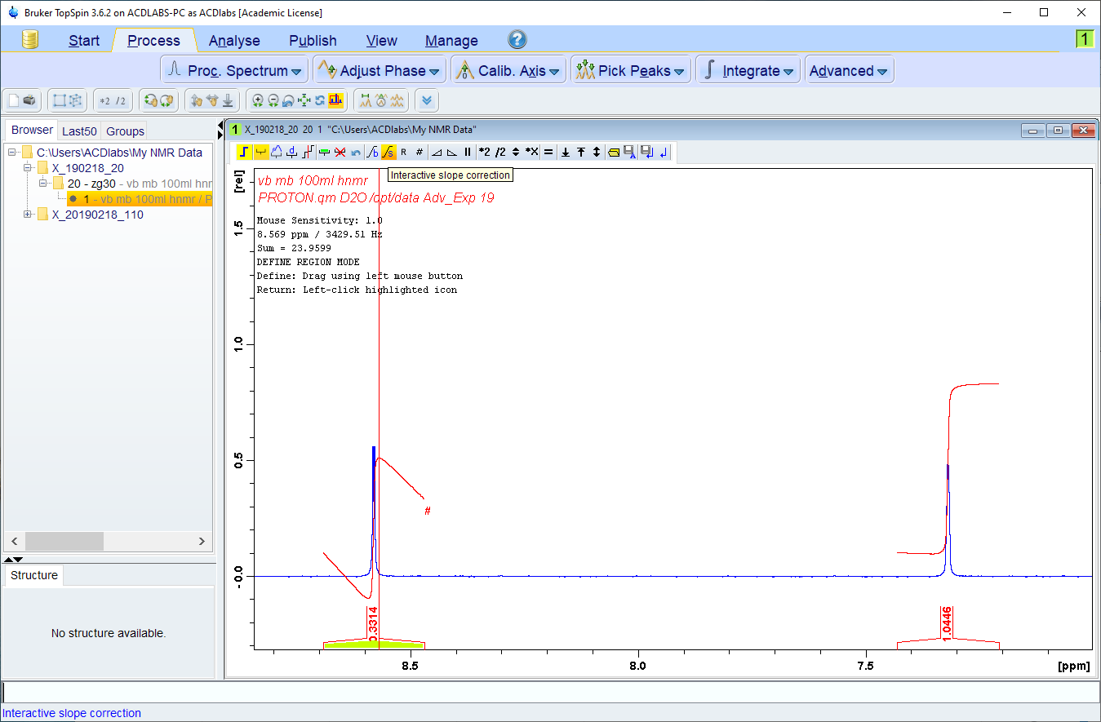
Slope is adjusted with the “s” icon. As with phase correction you need
to click and hold on the icon, then drag to make the adjustment.

Slide 25
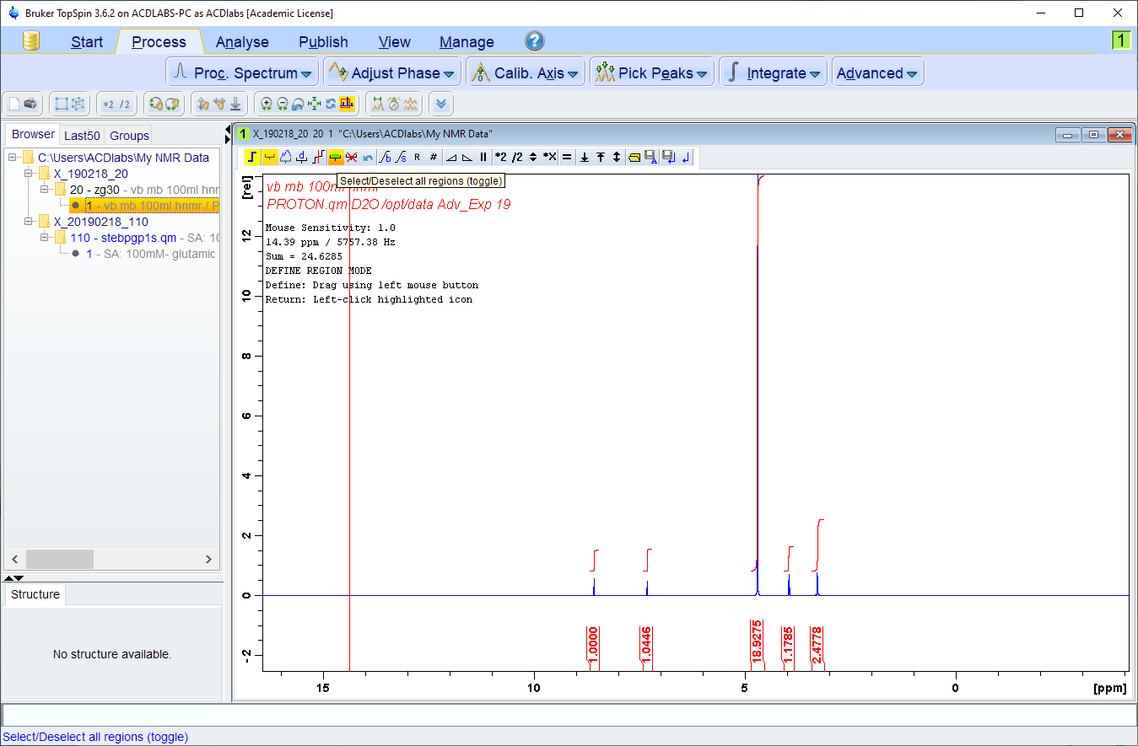
When you right click on an integral and select it, you can then right-
-click again to calibrate. There is also a button to select all integrals.

Slide 26
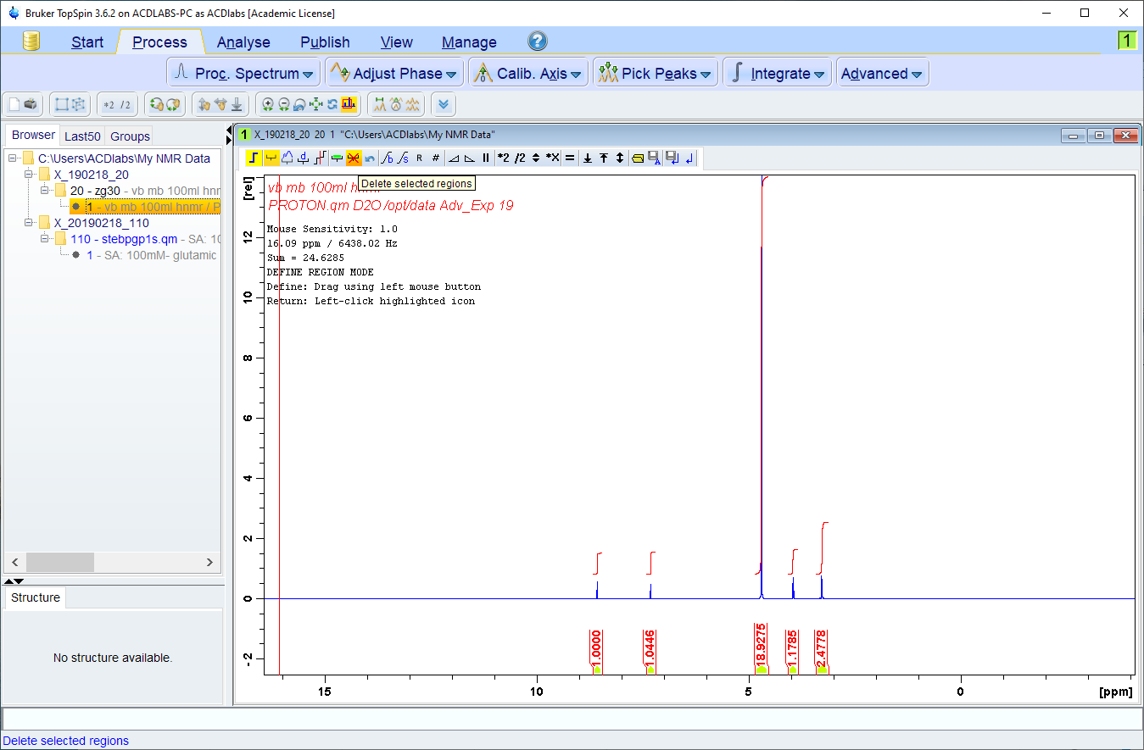
If you select all the integrals, there is also a button to delete them all
Which is useful if you make a mess and want to start again!

Slide 27
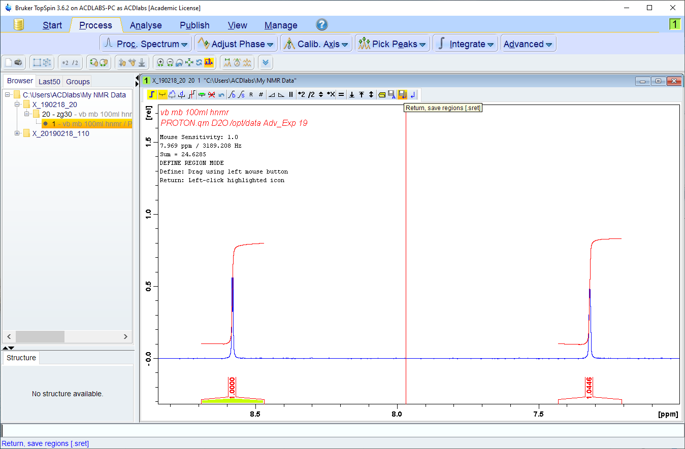
And again, as with phase correction, you need to save the results
when you’ve finished.

